Slide 1
SFTS
GROUP : CED-B2-005
MEMBERS : ASHIQUE M K
: JERIN JOSE
: YADU N M

Slide 2
INTRODUCTION
This dApp is intended to increase the transparency between the school management and the students.
This dApp will enable the students to view the amount of money that is spent on each commodities.
Also this can be implemented for other usecases such as,the fund that is collected for a Tech Fest in a College,what amount is spent for different activities can be made available,so that the money that is collected for a purpose is spent for that purpose and is not spent for someone’s personal interest.

Slide 3
FEATURES
Students can pay the fees through this system.
Management will be able to transfer the funds to the 3rd party firms for the services they provide.
Amount spent for different activities can be made available.

Slide 4
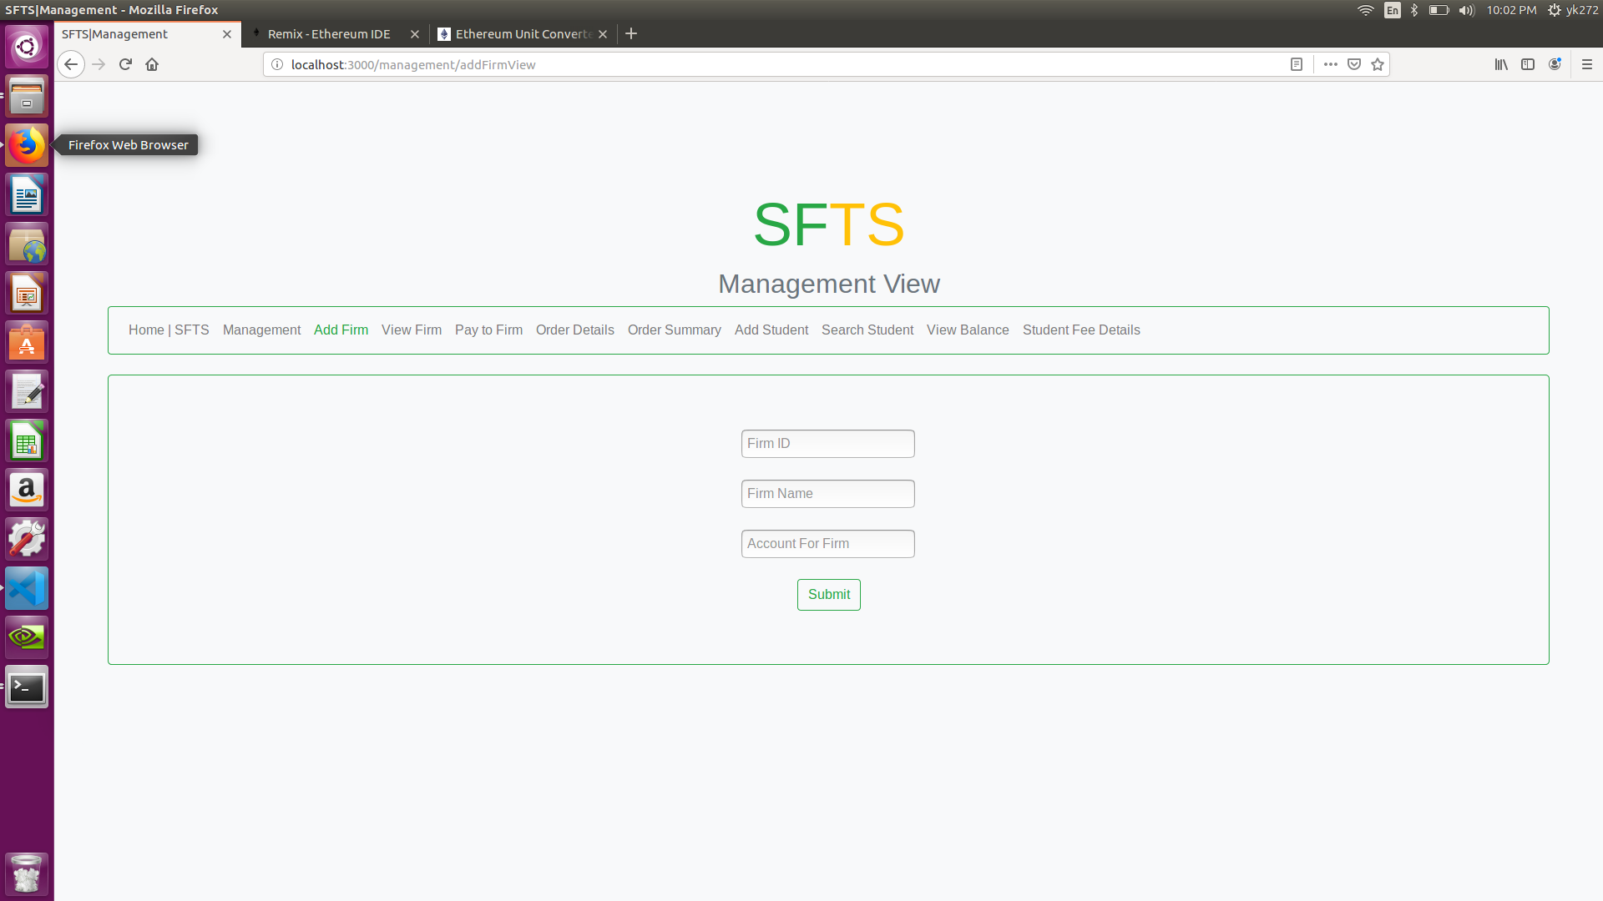
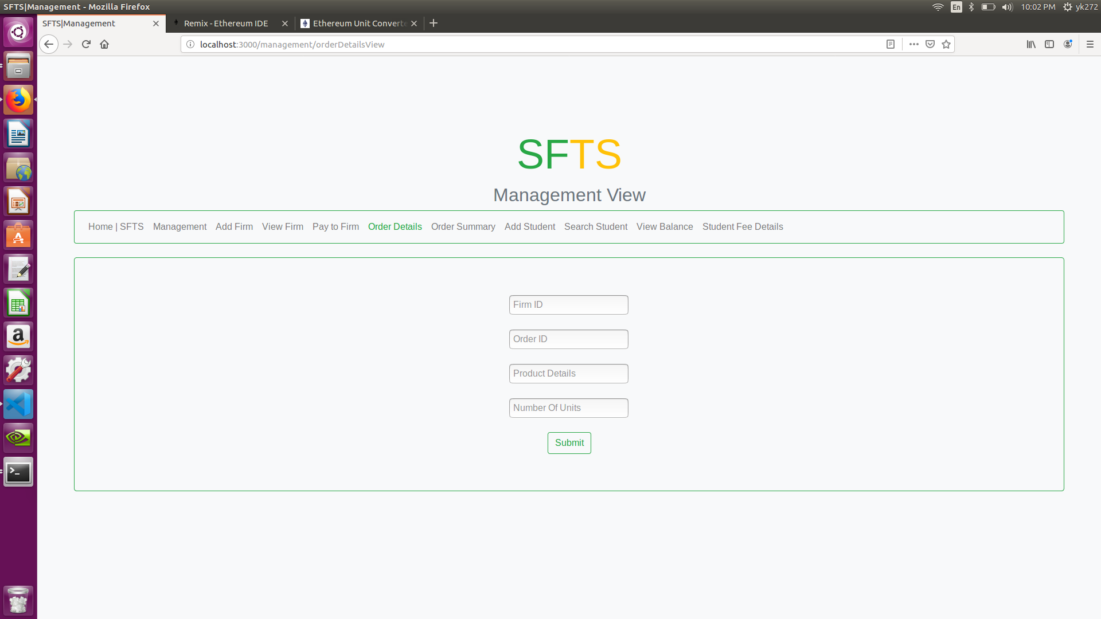
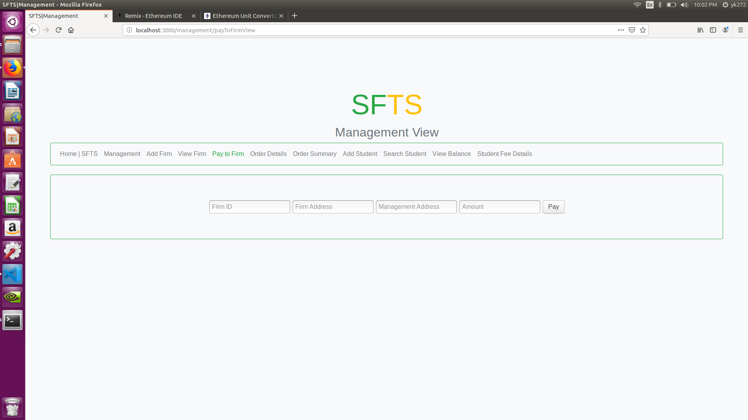
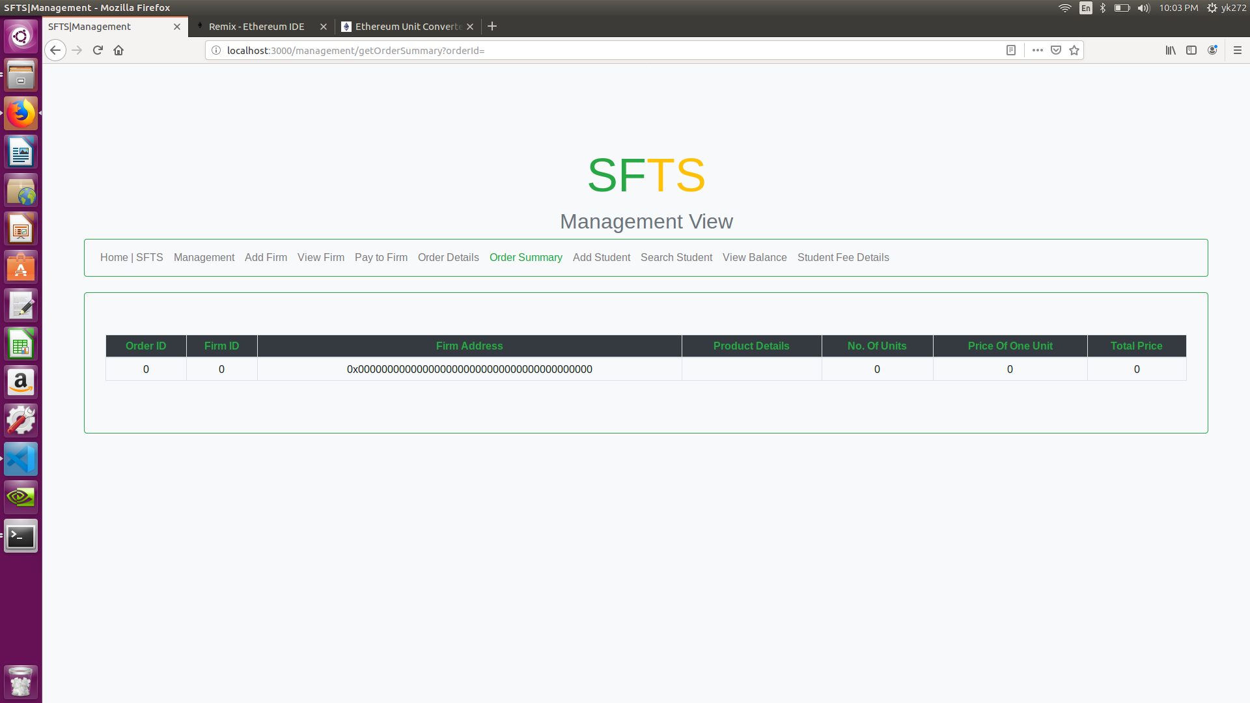
MANAGEMENT
1
3
2
4

Slide 5
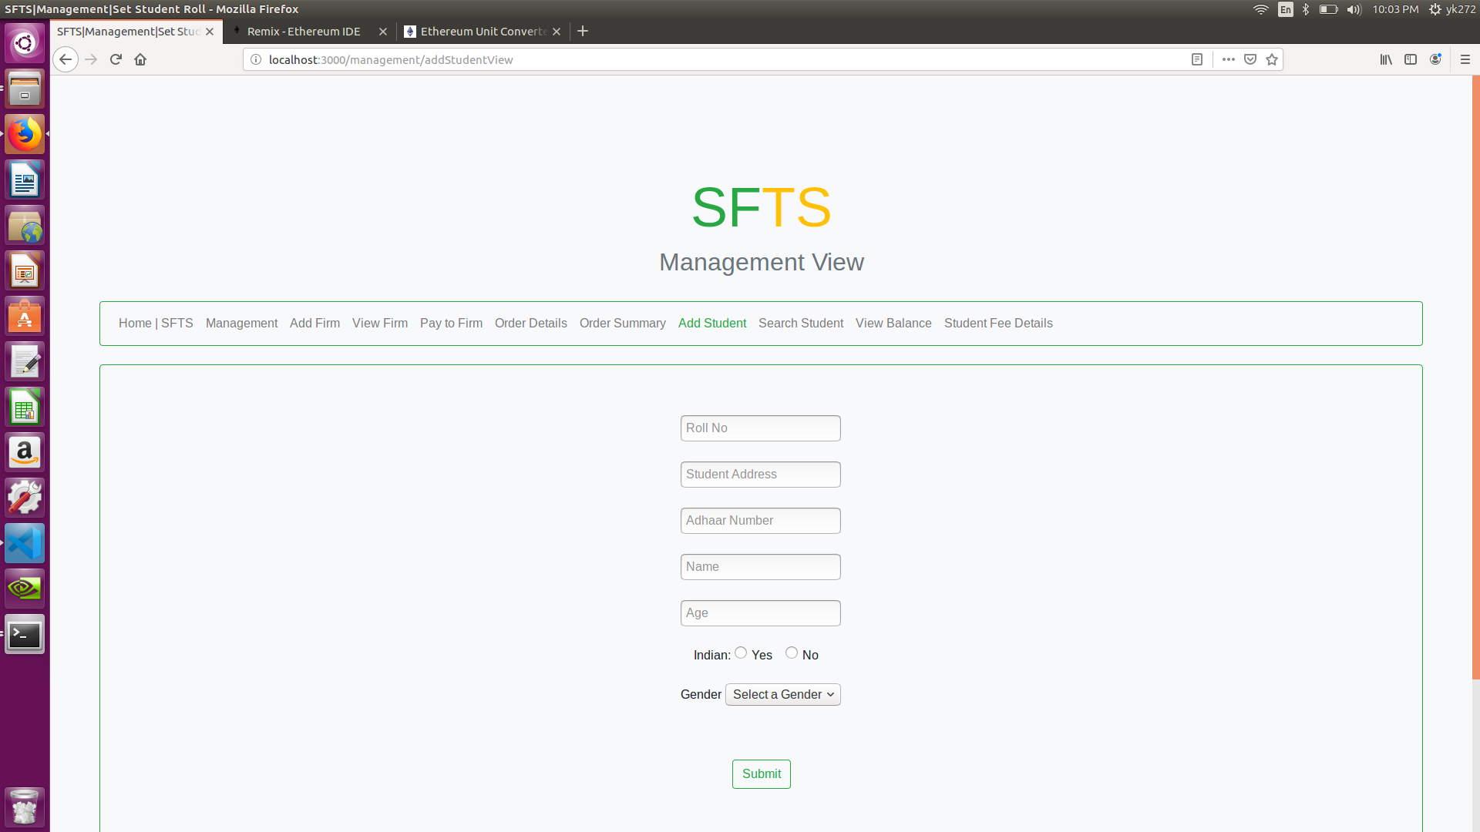
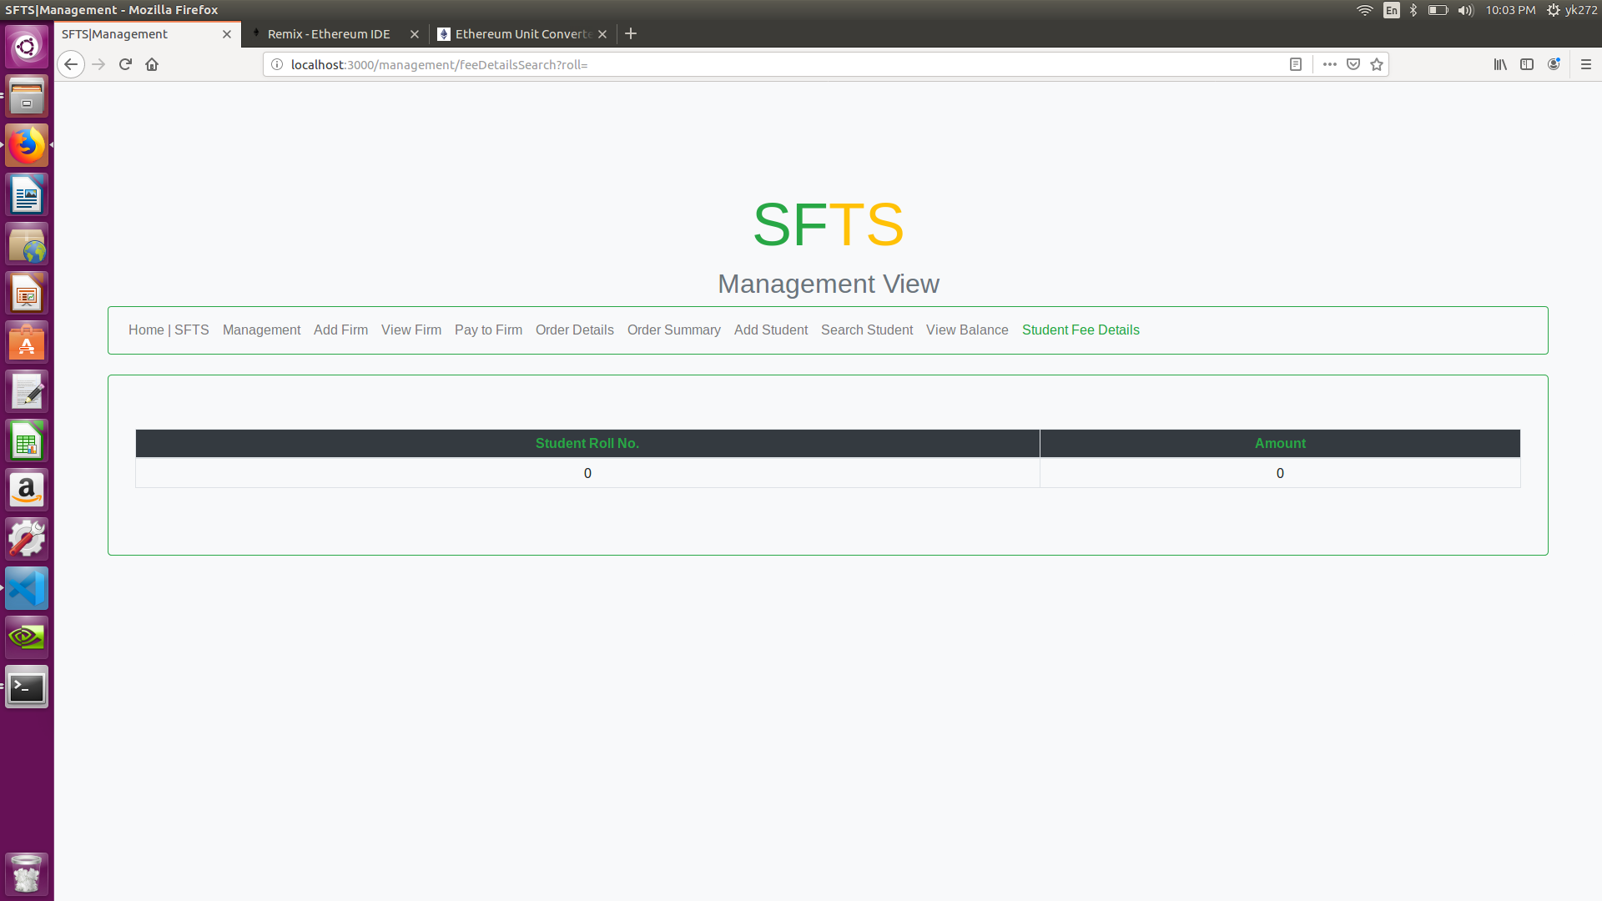
MANAGEMENT
5
6

Slide 6
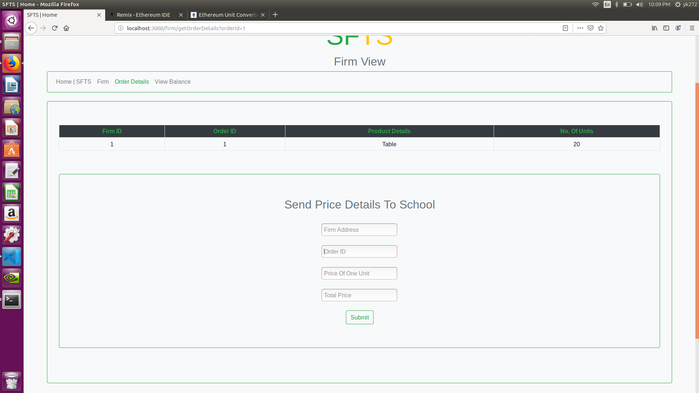
FIRM

Slide 7


STUDENT
1
2

Slide 8
THANK YOU

